Slide 1
Deep Reinforcement Learning and Ray Tracing

Slide 2
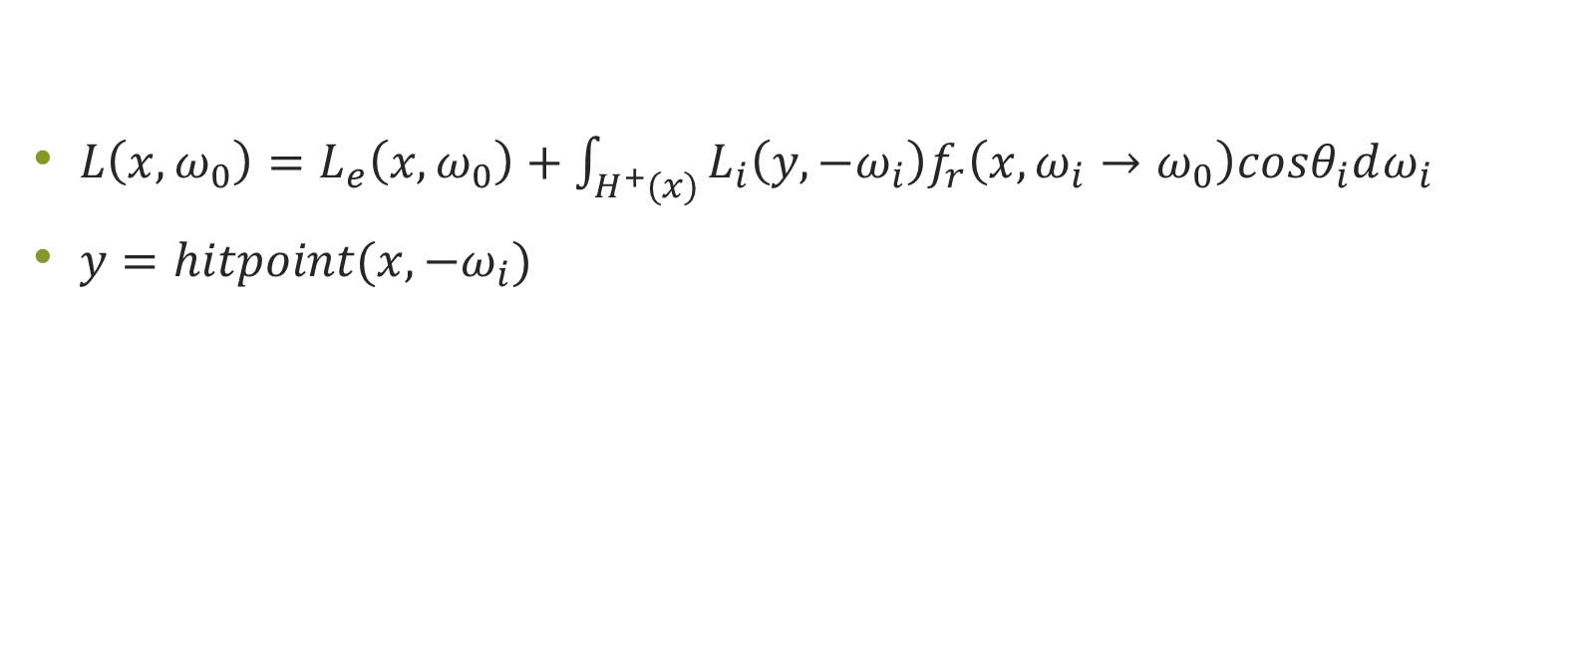
Rendering Equation
$L\left(x, ω_{0}\right)=L_{e}\left(x,ω_{0}\right)+\int_{H^{+}(x)}{L_{i}\left(y, {−ω}_{i}\right)f_{r}\left(x, ω_{i}→ω_{0}\right)cosθ_{i}dω_{i}}$
$y=hitpoint(x, −ω_{i})$

Slide 3
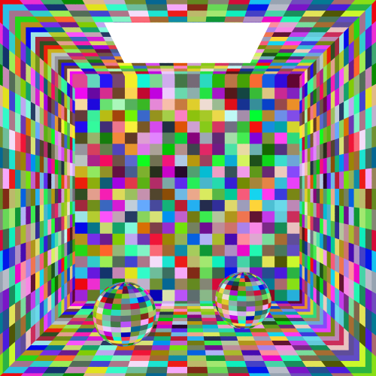
Reinforcement Learning
States: points on surfaces
Actions: directions
Q-learning :
Discretize states and actions
Deep Q-learning :
Only discretize actions

Slide 4
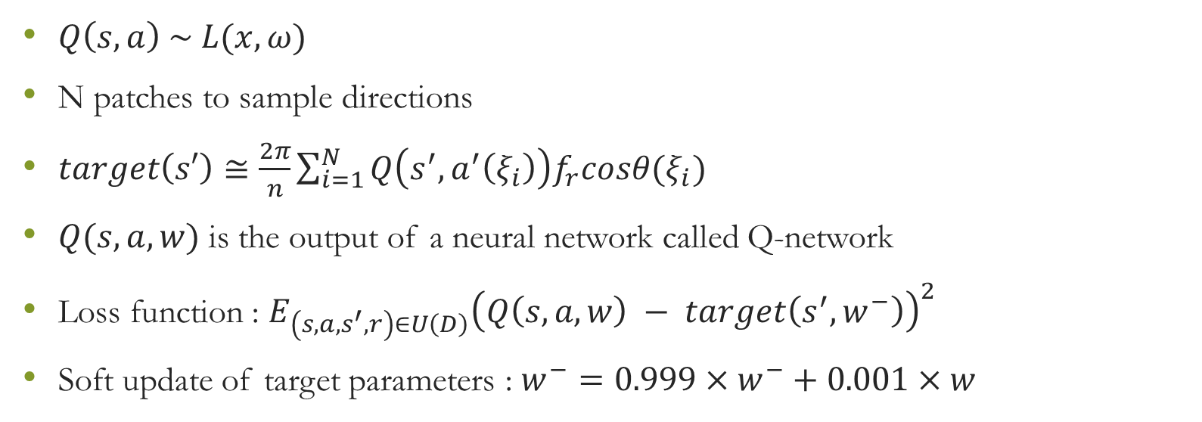
Deep Reinforcement Learning
$Q\left(s,a\right) \sim L(x,ω)$
N patches to sample directions
$target\left(s′\right)≅\frac{2π}{n}\sum_{i=1}^{N}{Q\left(s^{′}, a^{′}\left(ξ_{i}\right)\right)f_{r}cosθ(ξ_{i})}$
$Q(s,a,w)$ is the output of a neural network called Q-network
Loss function : $E_{\left(s,a,s^{′},r\right)∈U\left(D\right)}{\left(Q\left(s,a,w\right) − target\left(s^{′},w^{−}\right)\right)}^{2}$
Soft update of target parameters : $w^{−}=0.999×w^{−}+0.001×w$

Slide 5
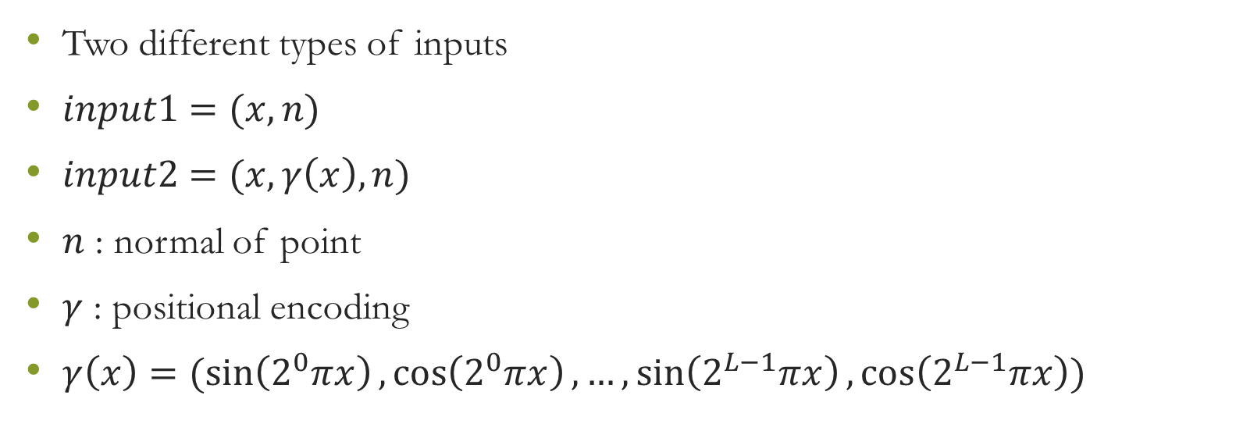
MLP Inputs
Two different types of inputs
$input1=(x, n)$
$input2=(x, γ\left(x\right),n)$
$n$ : normal of point
$γ$ : positional encoding
$γ\left(x\right)=(\sin\left(2^{0}πx\right),\cos\left(2^{0}πx\right), …,\sin\left(2^{L−1}πx\right),\cos\left(2^{L−1}πx\right))$

Slide 6
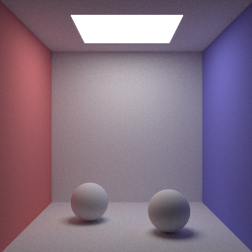
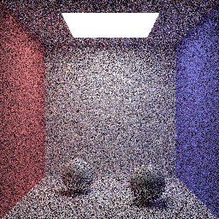
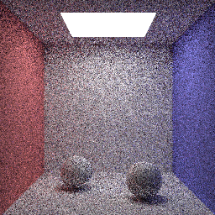
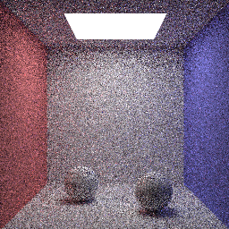
Scene 1: Uniform – DQN – DQN-POS

Slide 7
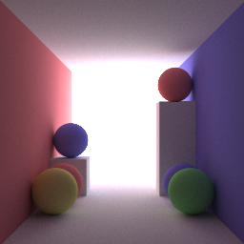
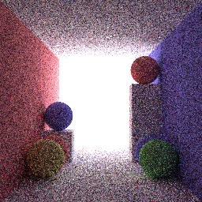
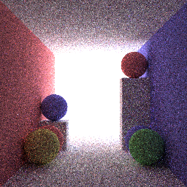

Scene 1: Uniform – DQN – DQN-POS

Slide 8
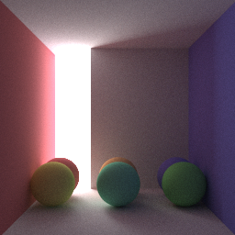
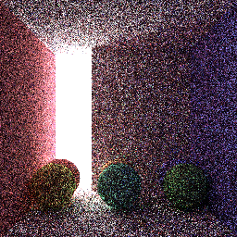
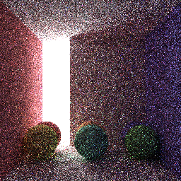

Scene 1: Uniform – DQN – DQN-POS

Slide 9
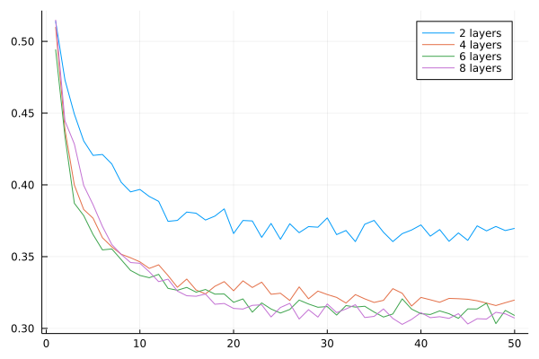
Loss Function : Depth
Number of layers: {2,4,6,8}
{Dense(54, H, relu), …,
Dense(H, 108, softplus)}
Each layers has 100 neurons

Slide 10
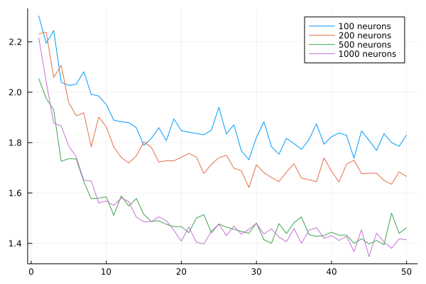
Loss Function : Width
Two-layer neural networks:
{Dense(54, H, relu),
Dense(H, 108, softplus)}
H values plot

Slide 11
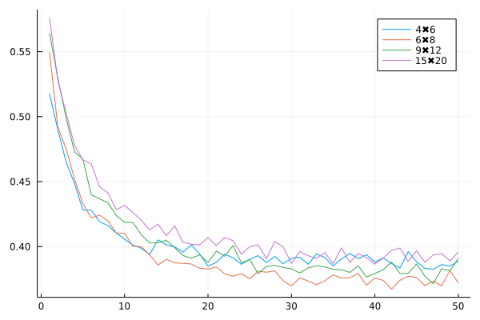
Loss Function : Discretization Resolution
Action space resolutions
{4×6, 6×8, 9×12, 15×20}

Slide 12
MAPE Error
Two-layer neural networks
{Dense(in, 1000, relu),
Dense(1000, 108, softplus)}
In = {6, 54}

Slide 13
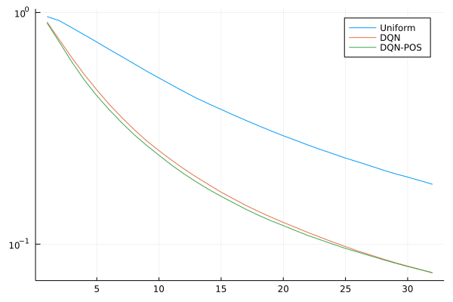
MAPE Error

Slide 14
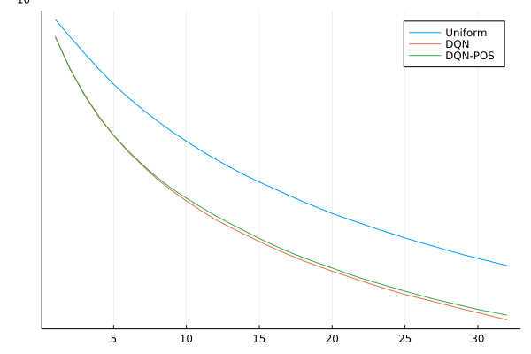
MAPE Error

Slide 15
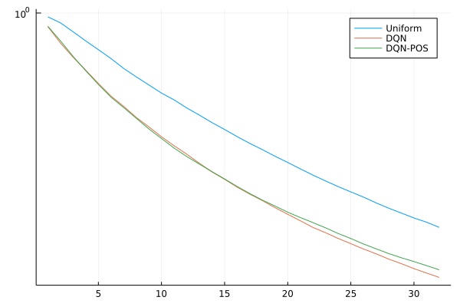
MAPE Error

